Slide 1


Why Hardware Startups Fail
Heider Jeffer
Supervisor: Prof. Xiaofeng Wang

Slide 2
Why I Chose this Research?

Slide 3
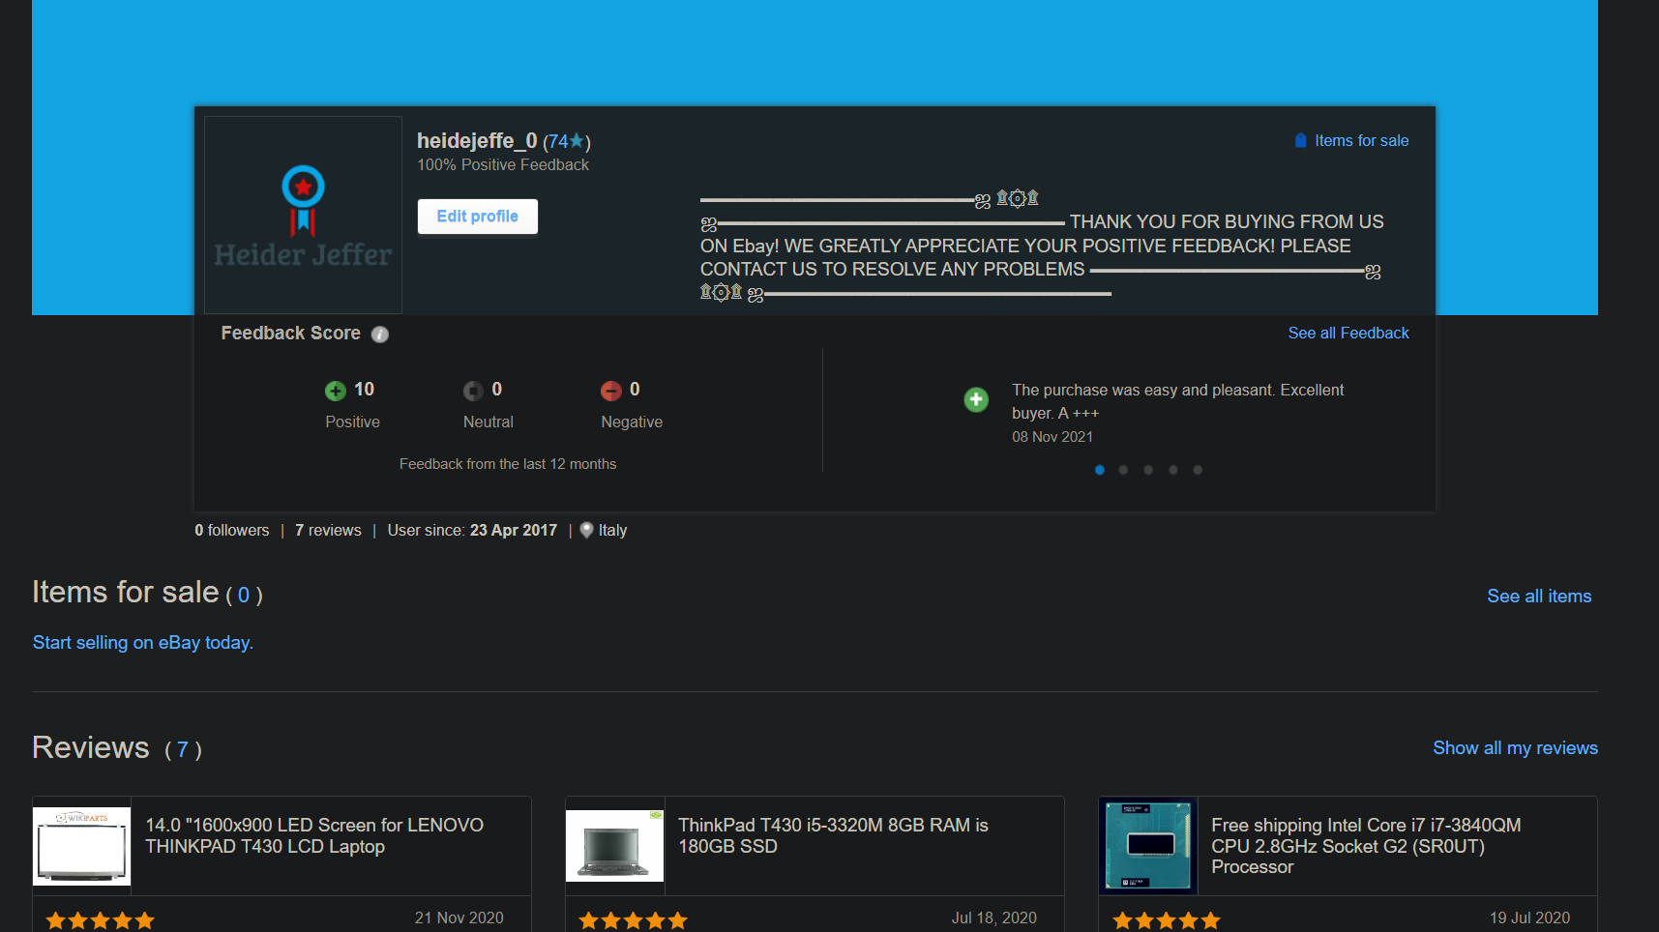

Slide 4
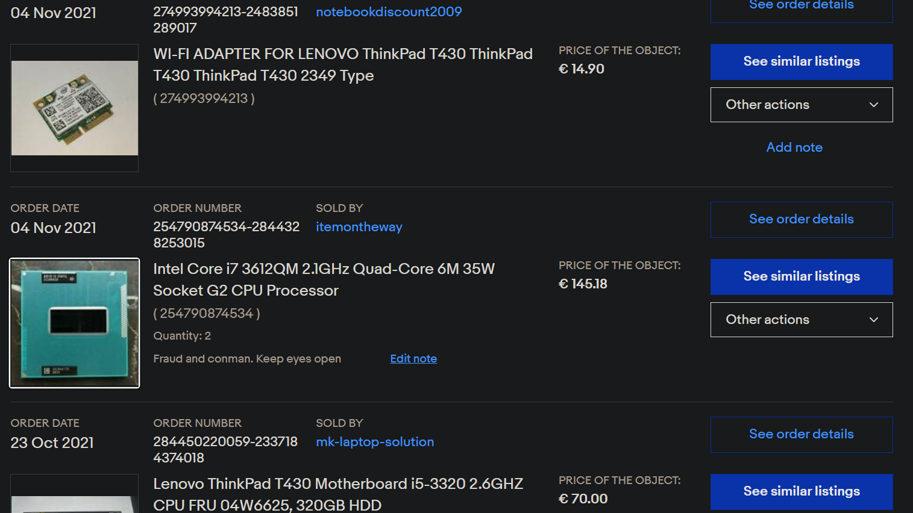

Slide 5
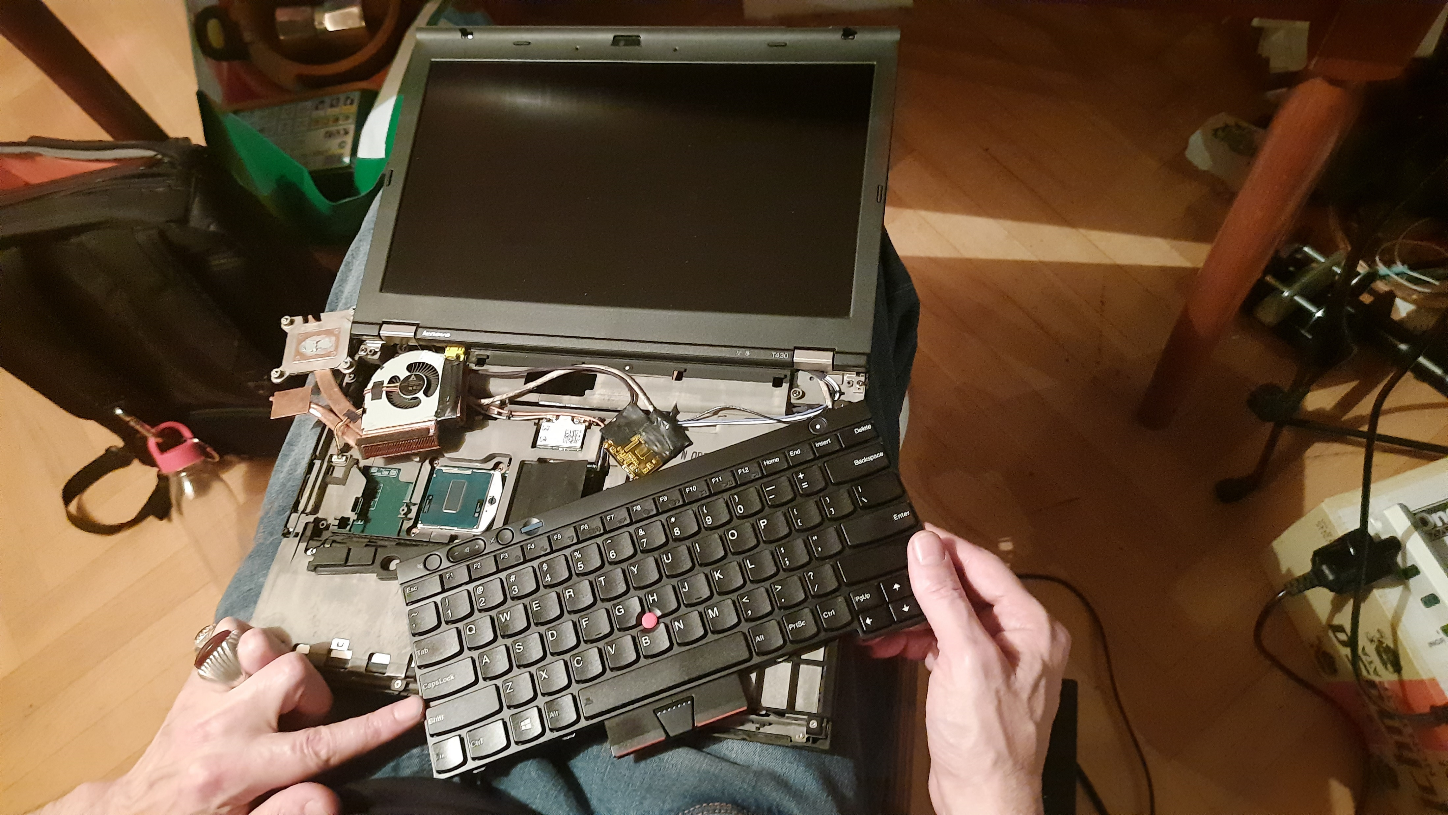

Slide 6
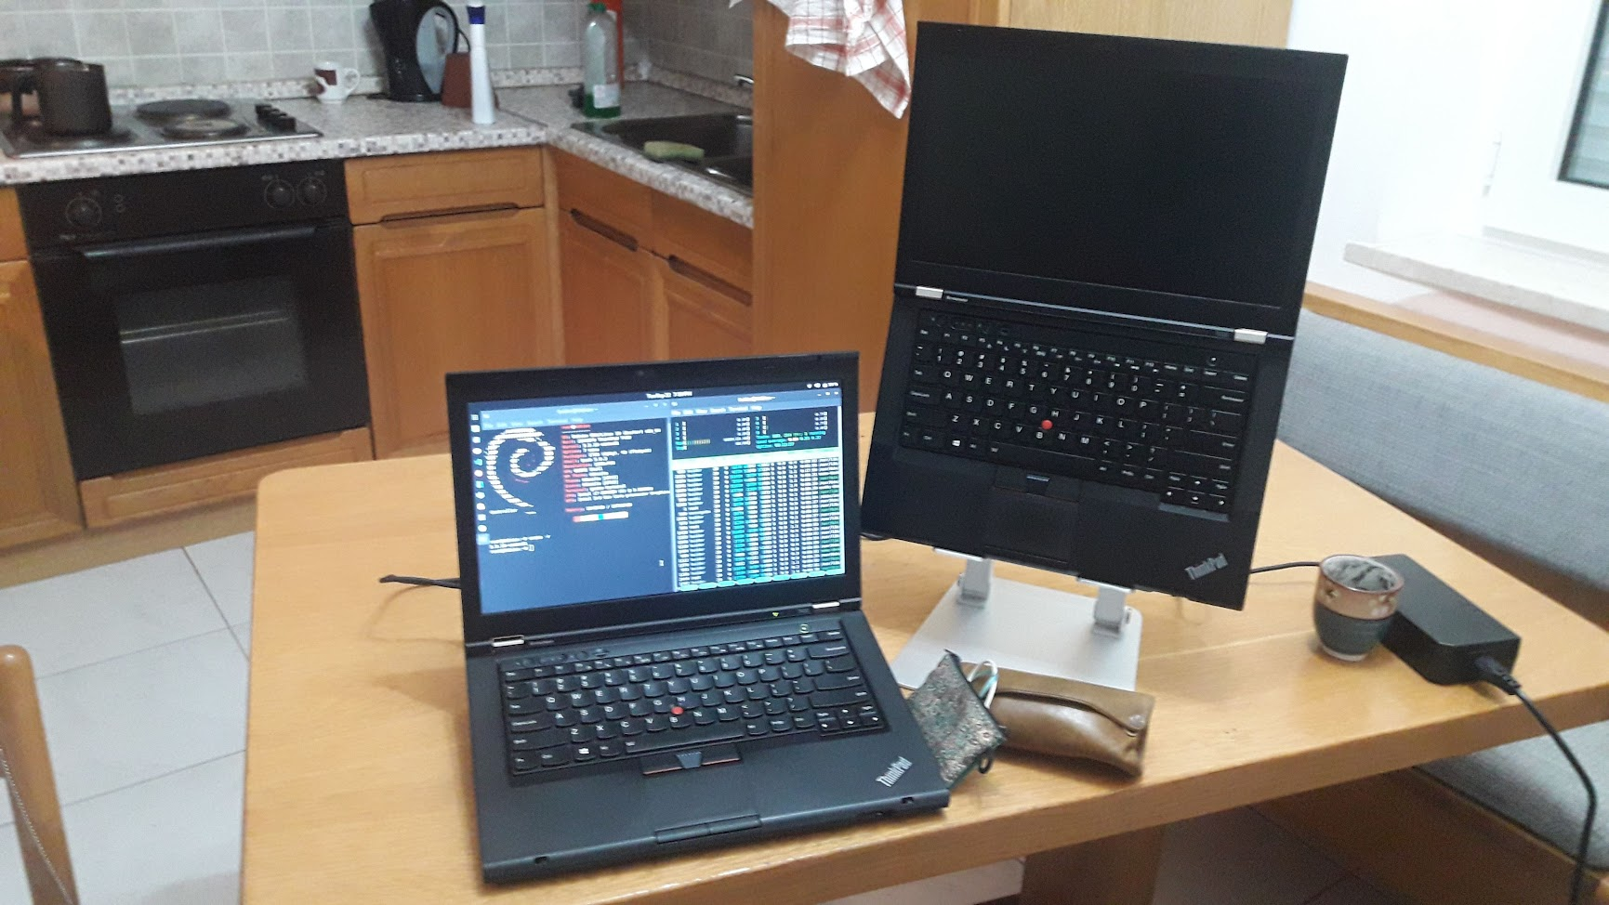

Slide 7
Problem Statement
Hardware startups often fail.
We need to address an answer for why hardware startups fail, to improve the future of the hardware startups.
Hardware Startups still based on trial-and-error, intuition, individual convenience, without any scientific paper, scientific models, or theoretical foundation.
We developed sets of logical rules and steps to extract the factors that cause the failure of the hardware startups from any given data-sets.

Slide 8
Research Question Why Do Hardware Startups Fail?

Slide 9
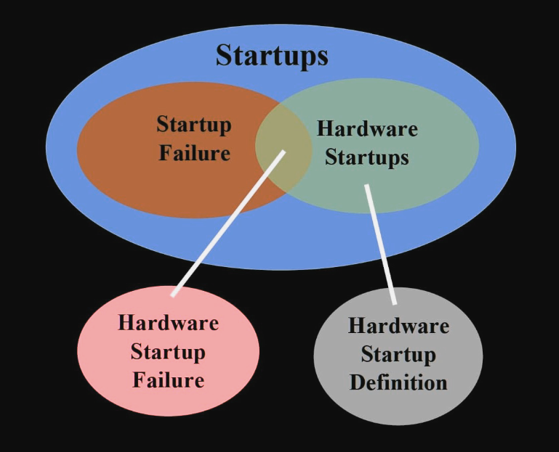
Background and Related Work

Slide 10
Background and Related Work (1) What is Hardware Startups?
Startups are project to create products or services and looking for ongoing business models to sell the product and make profit from it under uncertainty and extreme [1] [2].
Hardware Startups are Startups that build everything has mass, volume, and physically tangible [3] [4].

Slide 11
Background and Related Work (2) Studies on Hardware Startups
Stock and Seliger 2016 [25]. Principle Physical Parts. Electronic parts, Transistors
Duc et al. 2018 [26]. IoT with 4.0 Industry. Startups Management. Early Stage.
Li and Seering 2019 [28]. Linux and Community.

Slide 12
Background and Related Work (3) Why Startups Fail – According to CB-Insights
Failure Factors | CB-Insights 2018 | CB-Insights 2021
Ran out of cash | 29% | 38%
No market need | 42% | 35%
Get outcompeted | 9% | 20%
Legal Issues | 8% | 18%
Price cost issues | 18% | 15%
Poor product | 17% | 8%
Disharmonious: team investor | 13% | 7%

Slide 13
Background and Related Work (4) Studies Hardware Startups Failure
Griffith Erin article on Wired: The founders did not do enough to attract the investors, beside the crowdfunding alone will not bring the hardware startups to the market [27].
Anup Chathoth article on GeekWire: lack of consumer demand and high burn rate are two major factors behind the failure of more than 360 hardware startups [41].

Slide 14
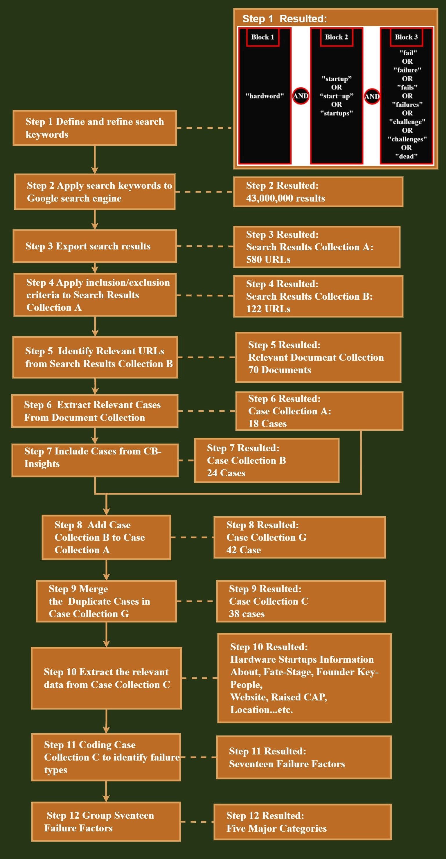
Research Approach
Data Collection Data Analysis Official Website

Slide 15
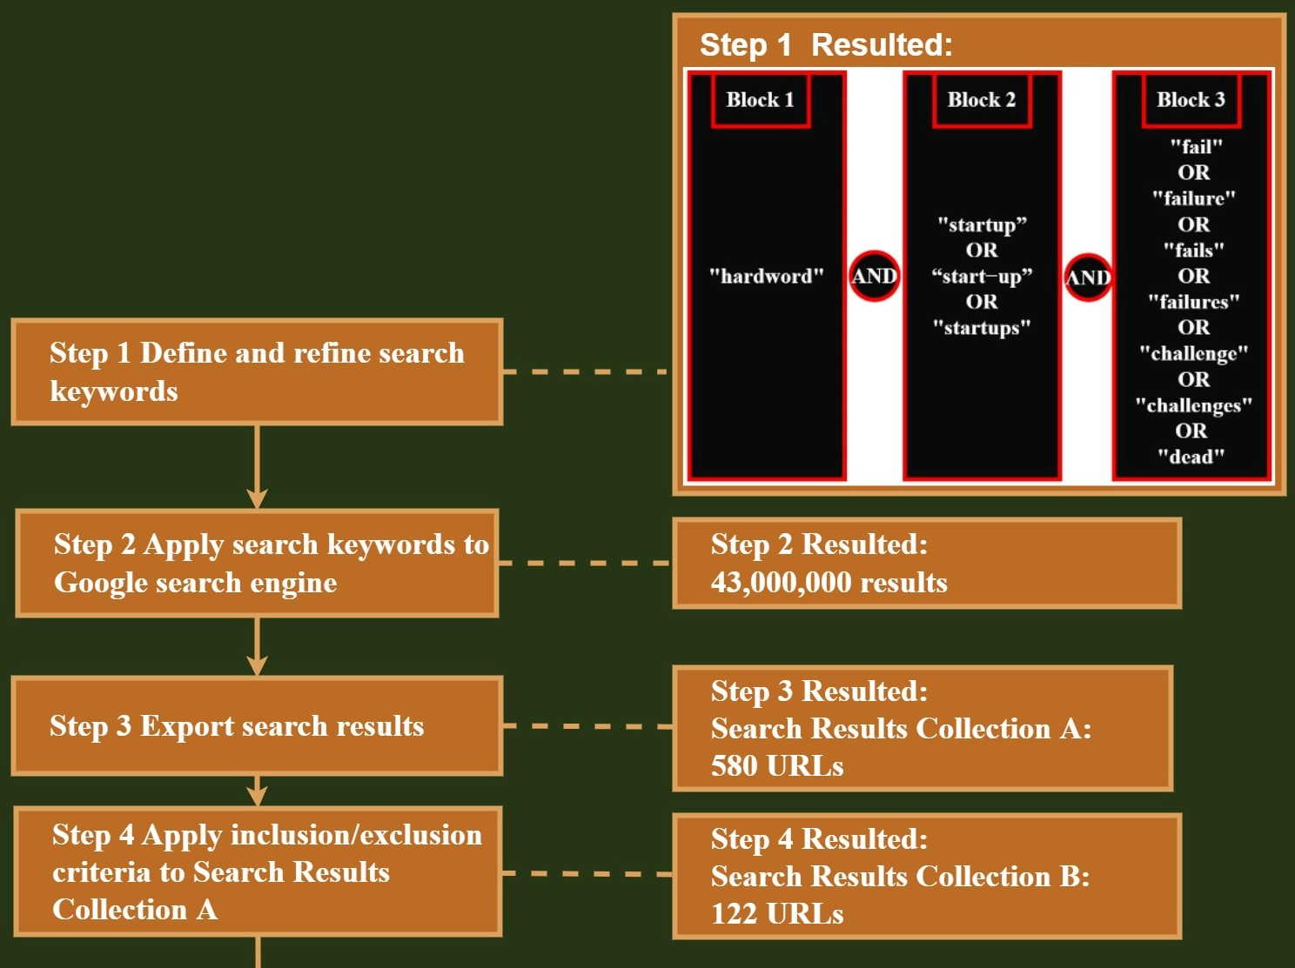
Data Collection

Slide 16
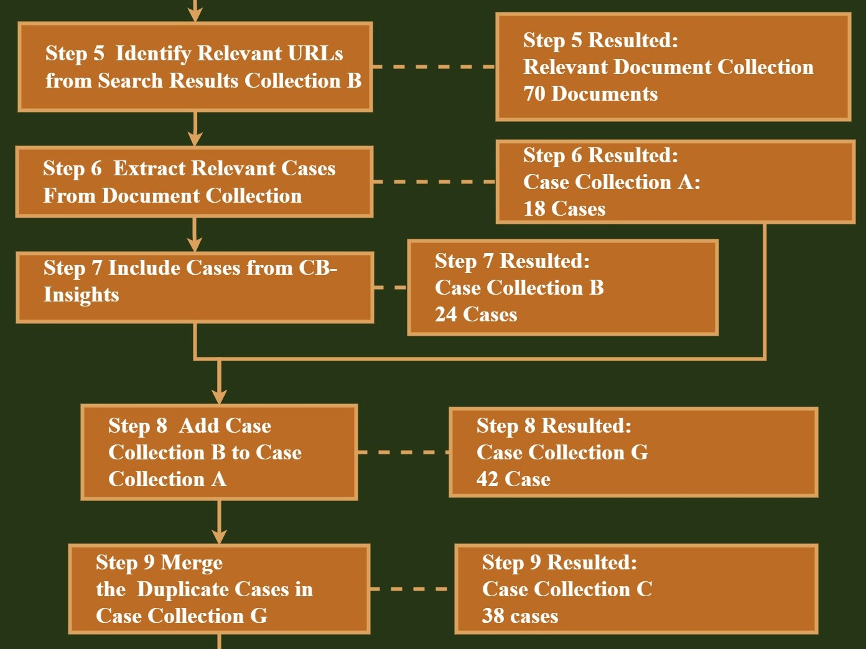
Data Collection

Slide 17
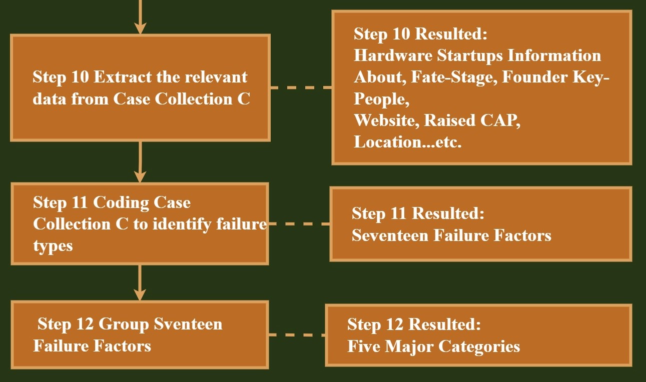
Data Analysis

Slide 18
Gilgamesh: official website –CopyLeft

Slide 19
Research Finding
The Major Failure Factors for Hardware Startups Exemplar Failure Factors and Cases

Slide 20
Failure Factors Category | Failure Factors
1. Customer and Market | Competition Ignore Customers Lack of demand Lack of interest after initial crowdfunding Poor Marketing
2. Hardware Product and Experts | Domain Expertise Lose Focus No Plan Manufacturing setbacks Poor Product Product Mis-Timed Product strategy mistakes
3. Financial | High burn rate No Financing or Interested Investors Pricing Cost Issues Ran Out Of Cash
4. Lack Business Model
5. Legal Issues
Research Finding (1):
The Major Failure Factors for Hardware Startups

Slide 21
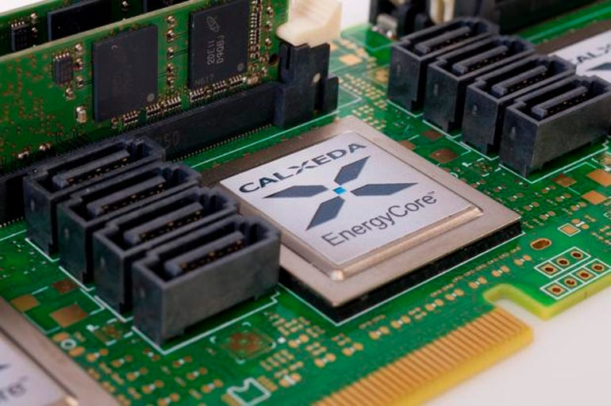
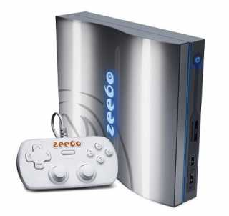
Research Finding (2) Exemplar Failure Factors and Cases
Failure Factor: Product strategy mistakes Exemplar Case: Calxeda
Failure Factor: Pricing Cost Issues Exemplar Case: Zeebo

Slide 22
Discussion
Most critical hardware startup failure factors Implication to hardware startup research Implication to hardware startups

Slide 23
Discussion (1)
Most critical hardware startup failure factors:
Product strategy mistakes. 9 case study. Learn from this failure factor is: Why hardware startup is hard.
Pricing Cost Issues. 9 case study. Learn from this failure factor is: Why hardware startup often failed.

Slide 24
Discussion (2)
IEEE show that the research question that we addressed in this paper is (Unique).
Implication to hardware startups - Keep it Simple and Stupid: This study is written in terms that hardware startups can understand. They can implement the tools that we developed to improve their products.
Implication to hardware startup research - Guideline to follow on: Developing logical steps to extract information related to hardware startups fail from any given data with any size type and format.

Slide 25
Contributions
provides a taxonomy of context of factors of hardware startups related to both the hardware startups and the researchers.
Definitions, classification, collecting and analysis over 43,000,000 documents of data only in the initial stage.
Processing 38 case study and extract from them information to answer the research question that this paper addressed.
A humble starting point for thorough discussions alternative approaches and new ideas to understand better why the hardware startups often fail.

Slide 26
Limitation & Future Work
Include video and audio Specify the keywords

Slide 27
Limitation and Future Work: Include video and audio

Slide 28
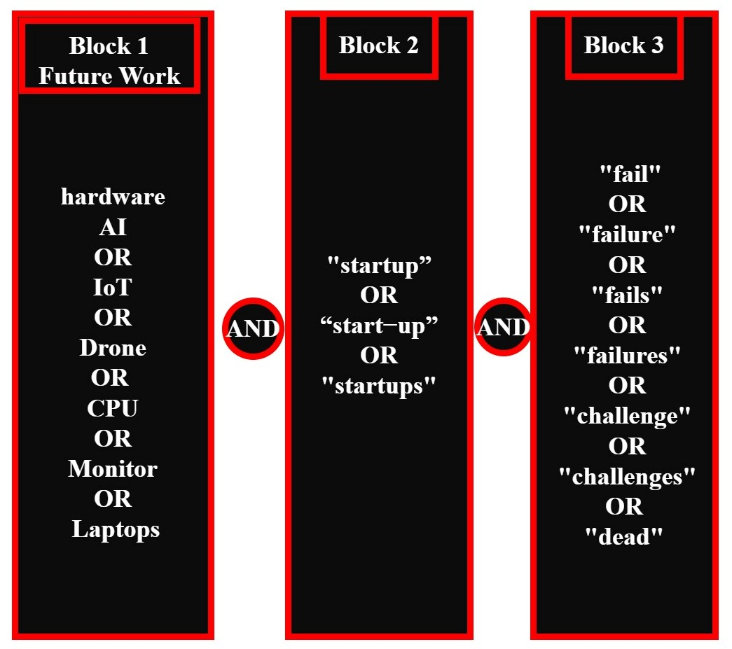
Limitation and Future Work: Specify the keywords

Slide 29
Bibliography
[1] E. Ries, The lean startup: How today’s entrepreneurs use continuous innova-
tion to create radically successful businesses. Currency, 2011.
[2] “What is a startup?,” Forbes, vol. 5, no. 7, pp. 56–15, 2016.
[3] S. Vocabulary, “the physical and electronic parts of a computer, rather than
the instructions it follows,” pp. 1–7.
[4] J. Stoltzfus, “What is hardware (h/w)?,” 2020. [5] T. Eisenmann, “Why start-ups fail,” 2021. Harvard Business Review (HBR)
[6] L. R. Pflanzer, “The history of $9 billion theranos and ceo elizabeth holmes,” 2019.
[7] J. Rago, “A drop of blood. an instant diagnosis, the wall street journal,” 2013.
[8] E. Holmes, “Elizabeth holmes, theranos ceo at tedmed 2014,theranos ceo elizabeth holmes spoke at tedmed 2014 in washington, dc about how her company
is disrupting lab testing.”
[9] J. Shieber, “Getting blood work done with elizabeth holmes of theranos, disrupt sf 2014.”
[10] J. Symonds, “British multinational pharmaceutical company headquartered in london, england.established in 2000 by a merger of glaxo wellcome and smithkline beecham.” [11] C. Pfizer and C. F. Erhart, “Pfizer: One of the world’s premier biopharmaceutical companies.”
[12] A. Salzman, “From unicorn hype to ’massive fraud’,” 2018.
[13] H. Jeffer, “A list of the names represents therano’s most accomplished board.,” 2022.
[14] S. Kunthara, “A closer look at theranos’ big-name investors, partners and board as elizabeth holmes’ criminal trial begins,” 2021.
[15] M. C. W. J. L. C. ERIN E. SCHNEIDER, “Securities and exchange commission, plaintiff, vs. elizabeth holmes and theranos, inc. defendants.,” UNITED STATES DISTRICT COURT NORTHERN DISTRICT OF CALIFORNIA SAN JOSE DIVISION, 2018.
[16] E. Griffith and E. Woo, “Theranos founder elizabeth holmes found guilty of four counts of fraud,” 1 2022.
[17] C. Uygur and A. Kasparian, “Elizabeth holmes found guilty of fraud.”
[18] CB-Insights, “Why startups fail: Top 12 reasons,” 2021. CB-Insights’
[19] K. S. spol ro, “Startup ecosystem survey 2016,” 2016.
[20] B. Ritholtz, “Learning lessons from failures of tech startups - bloomberg,”
[21] I. King, “Intel loses market share in server chips but makes gains in pcs (intc) - bloomberg,”
[22] T. Alsop, “Lenovo pc market share by quarter 2021, statista,”
[23] Intel, “Artificial intelligence startups - launch with intel,”
[24] Lenovo, “Small business technology solutions for start ups — lenovo tech today united kingdom,”
[25] T. Stock and G. Seliger, “Methodology for the Development of Hardware Star-
tups,” Advanced Materials Research, vol. 1140, no. August 2016, pp. 505–512, 2016.
[26] A. Nguyen-Duc, X. Weng, and P. Abrahamsson, “A preliminary study of agility in business and production: Cases of early-stage hardware startups,” 2018.
[27] E. Griffith, “Why Do Startups Fail? Because Hardware is Hard,” 2017.
[28] Zhuoxuan Li and Warren Seering, “Does open source hardware have a sustain able business model?,” pp. 2239–2248, August, 2019.

Slide 30
Bibliography
[29] U. Rafiq, J. Melegati, D. Khanna, E. Guerra, and X. Wang, “Analytics mis takes that derail software startups,” pp. 60–69, Association for Computing Machinery, 6 2021.
[30] C. U. Press, “Category meaning in the cambridge english dictionary.”
[31] E. M. Pothos and A. J. Wills, Formal approaches in categorization. Cambridge University Press, 2011.
[32] W. Croft, D. A. Cruse, et al., Cognitive linguistics. Cambridge University Press, 2004.
[33] E. E. representative, “Eban – europe’s leading early stage investors network,”
[34] I. R. Bedn´ar and I. N. Tariˇskov´a, “Indicators of startup failure,” vol. 240,
no. 5, pp. 238–240, 2017.
[35] CB-Insights-TECH, “Cb insights - technology market intelligence,”
[36] F. Times, “Financial times,”
[37] E. Griffith, “The next wave of ‘unicorn’ startups focus on software — the seattle times,”
[38] C. Insights, “Top 20 reasons Startups fail,” CB Insights, pp. 1–9, 2018.
[39] C. Insights, “Top 12 reasons startups fail,” CB Insights, pp. 1–26, August 3, 2021.
[40] R. Hat, “Red hat - we make open source technologies for the enterprise.”
[41] A. CHATHOTH, “Hardware isn’t hard: A startup playbook for succeeding in a sector where many have failed,” 2020. GeekWire
[42] C. Freeman, “Grey literature: What is grey literature,”
[43] S. S. Bajwa, X. Wang, A. N. Duc, and P. Abrahamsson, ““failures” to be celebrated: an analysis of major pivots of software startups,” Empirical Software Engineering, vol. 22, pp. 2373–2408, 10 2017.
[44] HeiderJeffer, “Outcome of extracting the relevant data from case collection b,” 2022.
[45] L. Richards and J. M. Morse, Readme first for a user’s guide to qualitative methods. Sage, 2012.
[46] Nvivo, “What is coding? deciding on an approach, ’broad-brush’ coding using queries, coding in files, coding entire files to a node, datasets.”
[47] R. Thornberg and K. Charmaz, Grounded Theory and theoretical coding, pp. 153–169. 06 2014.
[48] H. Jeffer and X. Wang, “Gilgamesh official website for qualitative thematic data analysis,”
[49] C. Insights, “Page 10, get outcompeted, top 20 reasons startups fail-,” CB Insights, pp. 1–9, 2018.
[50] CB-Insights, “T0p 9 and top 20 reasons startups fail.”
[51] CB-Insights, “Page 6, lack of interest after initial crowdfunding, the top 9 reasons hardware startups fail - cb-insights.”
[52] CB-Insights, “Page 5, manufacturing setbacks, the top 9 reasons hardware startups fail - cb-insights.”
[53] Angel, “Angel Sensor,” 2019.
[54] CB-Insights, “Page 6,high burn rate, the top 9 reasons hardware startups fail - cb-insights.”
[56] T. R. Eisenmann and D. Kiron, “Aquion Energy,” 2011.
[57] “Airware Dorne.”
[58] Ubuntu, “Ubuntu for the internet of things.”

Slide 31

Thank You

Slide 32
Questions, please?

